Slide 1
Visualization Tasks Case Study
File created on: 10/1/2023 9:00:36 AM

Slide 2
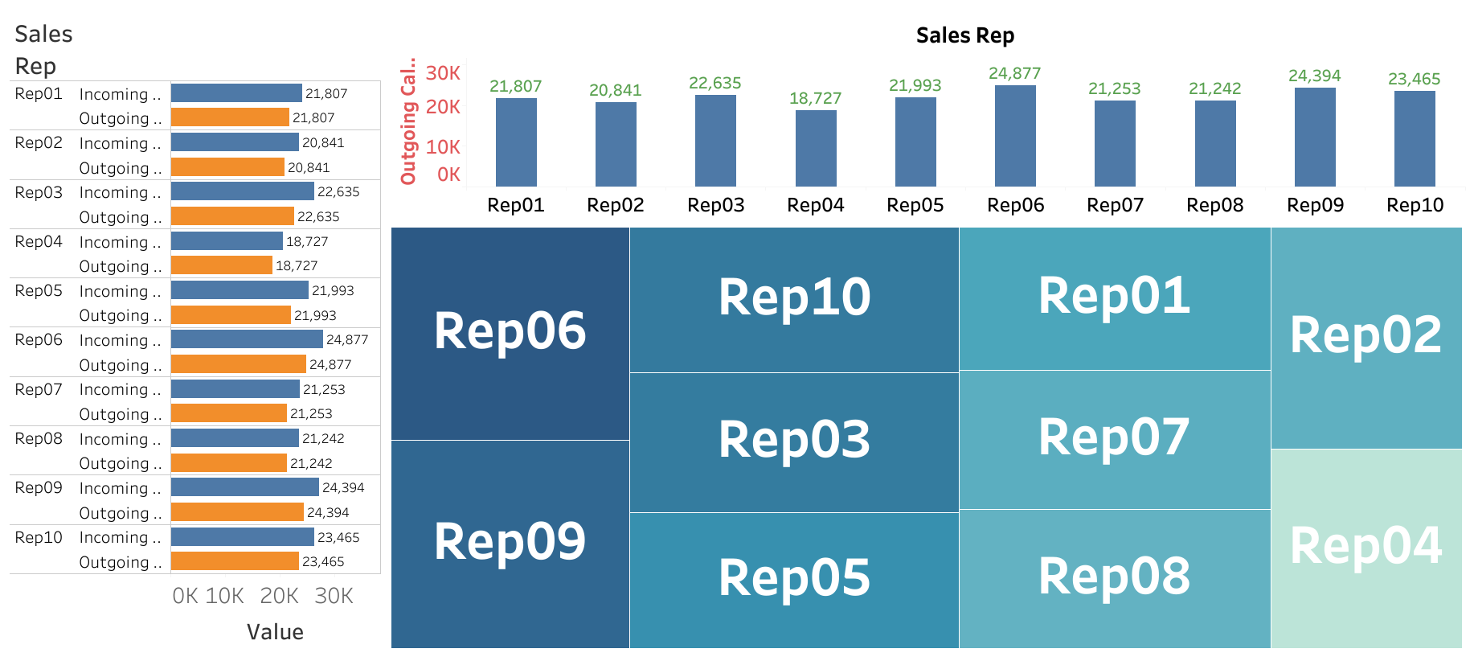

Slide 3
https://public.tableau.com/app/profile/ashfaque.shaikh6706/viz/VisualizationTasksCaseStudy/Dashboard1?publish=yes

